Slide 1
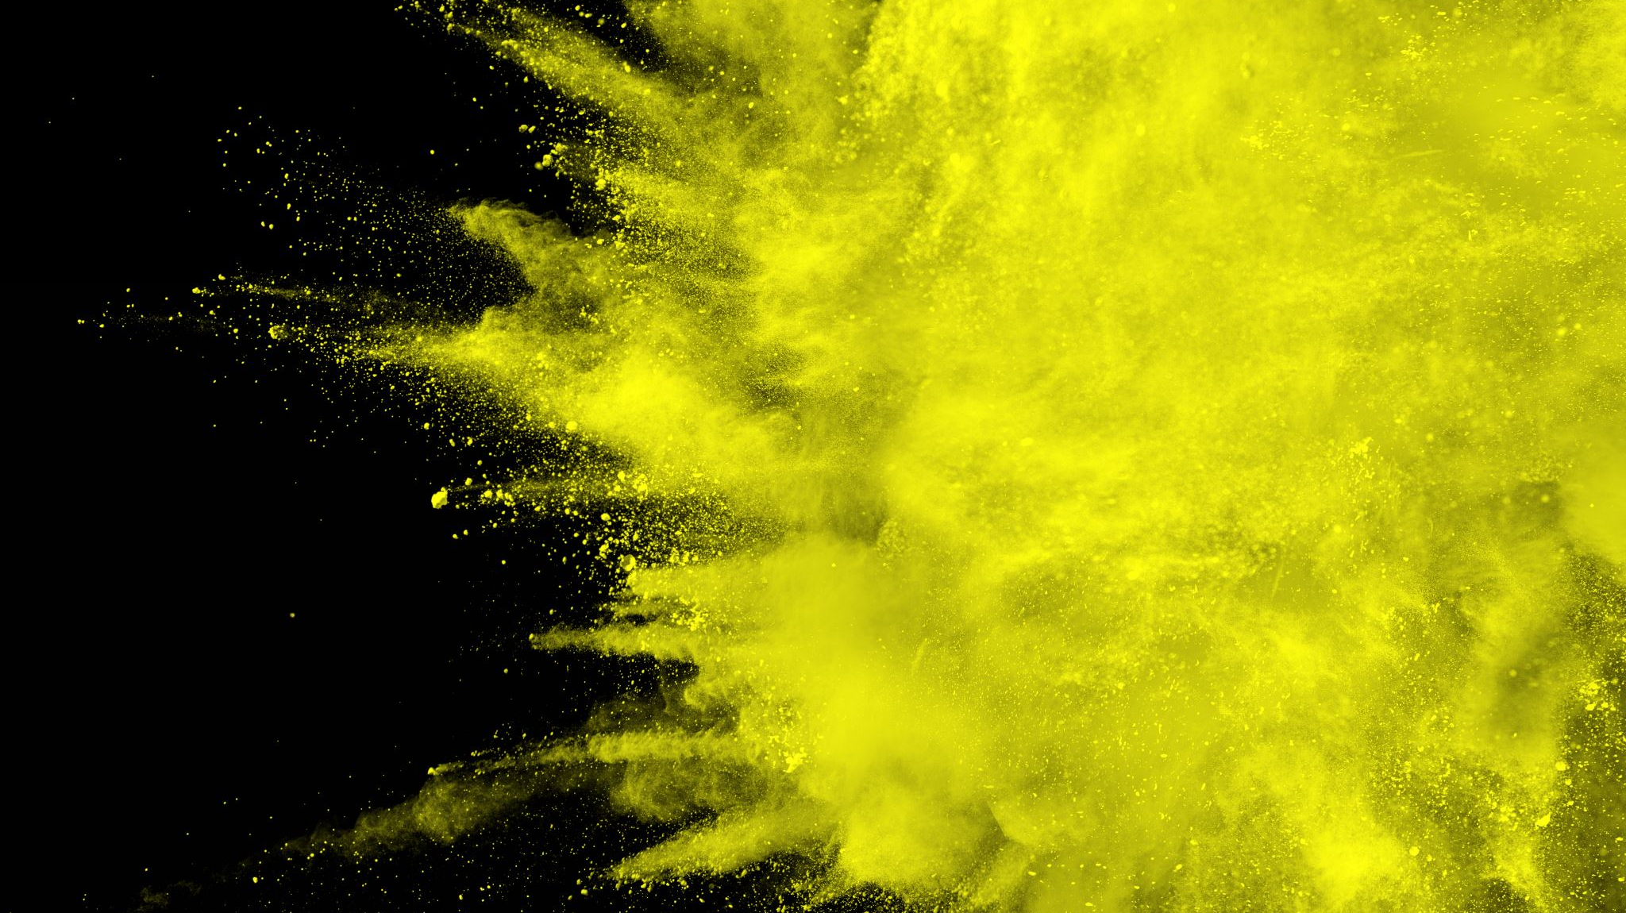
Rates of Reaction
Collision theory and factors effecting the rate of reaction

Slide 2
Outline
Collision theory
Activation energy and energy profile diagrams
Factors that effect rate of reaction
  Concentration
  Pressure
  Surface area
  Temperature
  Catalysts

Slide 3
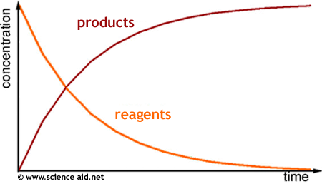
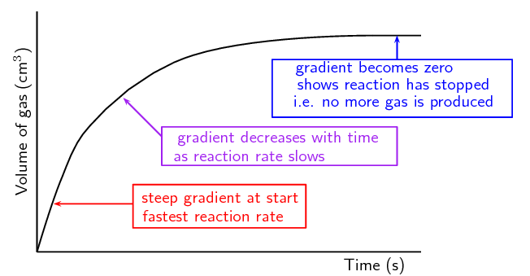
Review: Measuring rate of reaction
Rate of reaction = amount of substance used or produced time taken
Can be measured in moles per second, grams per second litres per second
Shows the formation of products or the consumption of reactants

Slide 4
Collision theory
The way in which reactions occur can be understood in terms of collision theory
  The reacting particles must collide
  The particles must collide with enough energy to equal or exceed a certain amount (activation energy Ea)
  Reacting particles must collide in a suitable orientation
All three of these must occur for a reaction to proceed

Slide 5
Activation energy
The minimum energy that colliding particles must have in order to react is called the activation energy.
You can think of the activation energy for a reaction as a barrier that reactants must cross before products can form.
As reacting particles approach each other, repulsive forces between electron clouds causes them to slow down and lose kinetic energy
This lost kinetic energy converts to increased potential energy of the colliding particles
If they have enough kinetic energy they will approach close enough (collide) to form a transition state also known as the activated complex – the highest potential energy state

Slide 6
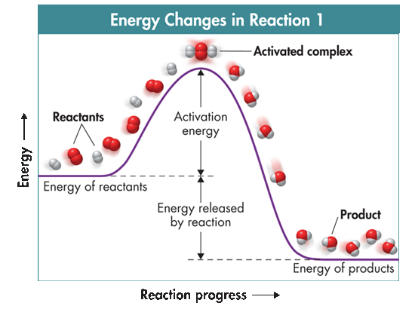
Activation energy
The activation-energy barrier must be crossed before reactants are converted to products.
Exothermic or endothermic?

Slide 7
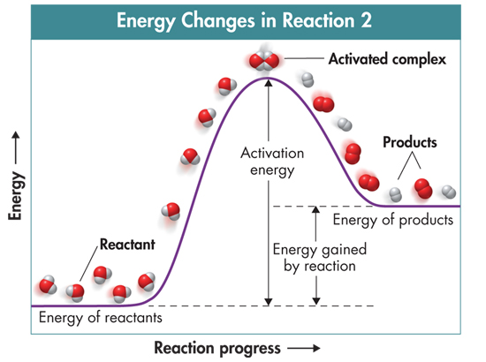
Activation energy
Exothermic
Endothermic

Slide 8
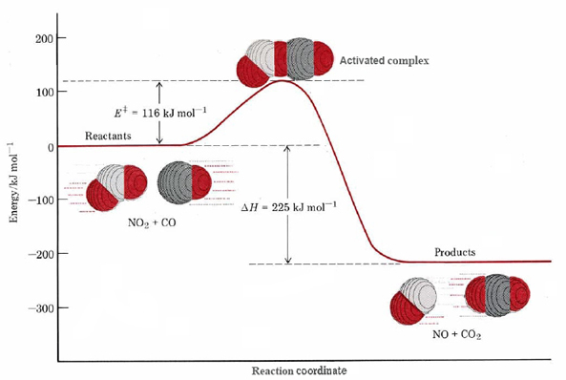
Transition state
The transition state is where the original bonds are being broken and new bonds are being formed
It is an unstable arrangement; its brief existence ends with the reformation of the reactants or with the formation of products
The minimum collision energy required to form the transition state is known as the activation energy Ea

Slide 9
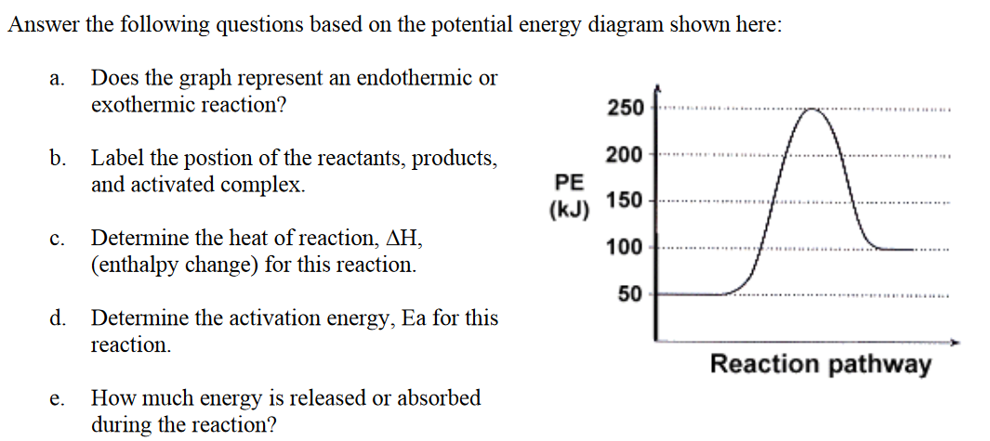
Understanding check

Slide 10
Understanding check
Transition state
Endothermic
products
∆H = + 50 kJ
∆H
reactants
Ea = 200 kJ
50 kJ of energy is absorbed in the reaction

Slide 11
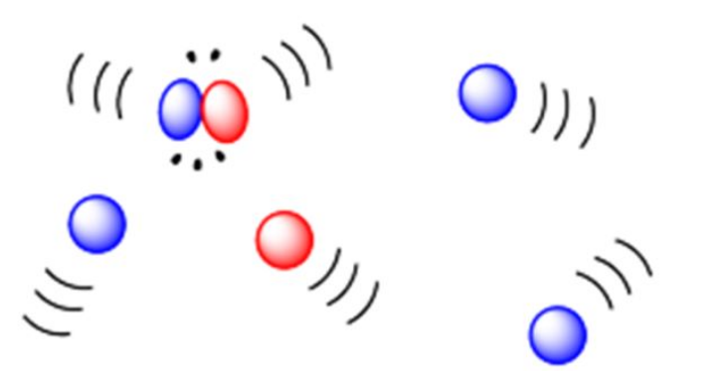
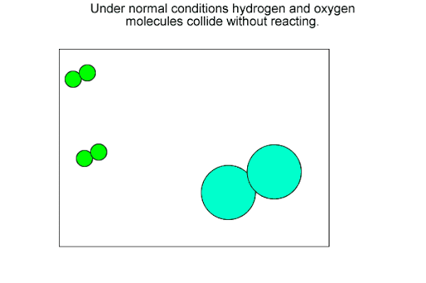
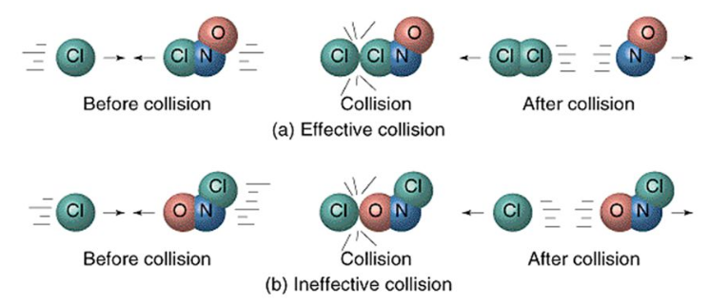
Collision theory
Must collide to react
Needs enough energy
Needs correct orientation

Slide 12
Factors effecting rate
Factors that effect rate of reaction
  Concentration / Pressure
  Surface area
  Temperature
  Catalysts
Keys Questions:
    Does it increase the frequency of collisions?
    Does it increase the frequency of successful collisions?

Slide 13
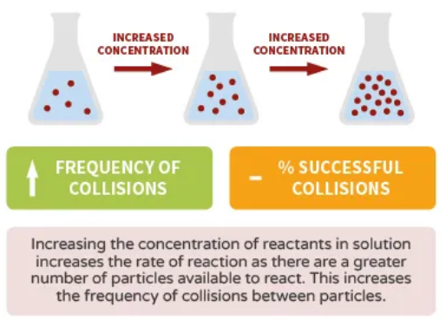
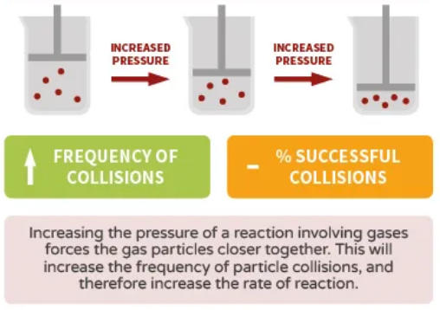
Concentration / Pressure
The number of particles in a given volume affects the rate at which reactions occur.
Cramming more particles into a fixed volume increases the concentration of reactants or increases the pressure,
thus, the frequency of collision.
Increased collision frequency leads to a higher reaction rate.

Slide 14
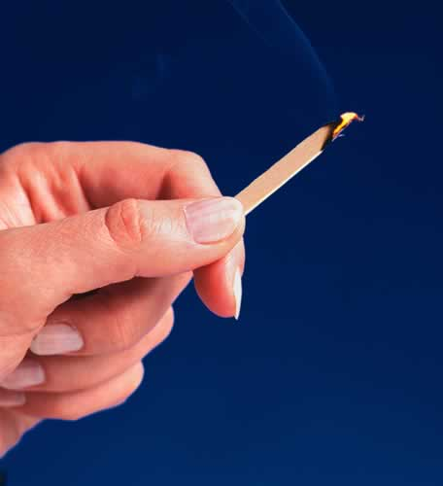
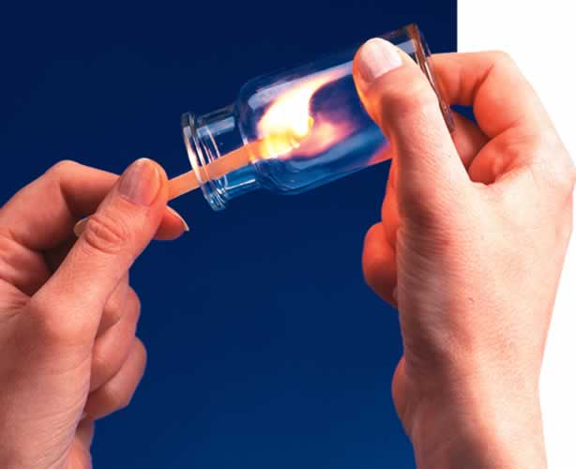
Concentration / Pressure
The number of particles in a given volume affects the rate at which reactions occur.
The lighted splint glows in air and soon dies out because air is only 20% oxygen.
When the glowing splint is plunged into pure oxygen, it immediately bursts into flame. The increased concentration of oxygen greatly speeds up the combustion reaction.

Slide 15
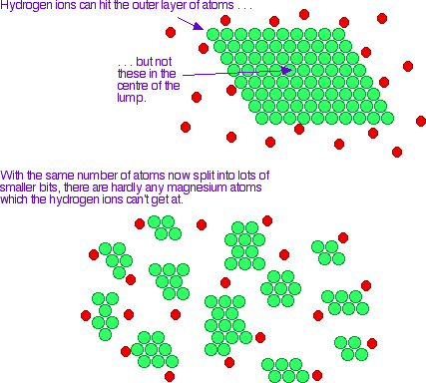
Particle size (surface area)
The total surface area of a solid or liquid reactant affects the rate of a reaction.
  Reacting particles can only collide at surface boundaries where the phases make contact
  Increasing the surface area exposes a greater amount of reacting particles to the possibility of collision
  This results in increases frequency of collisions

Slide 16
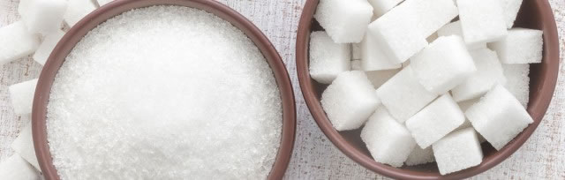
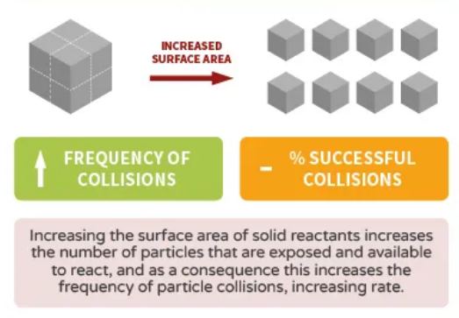
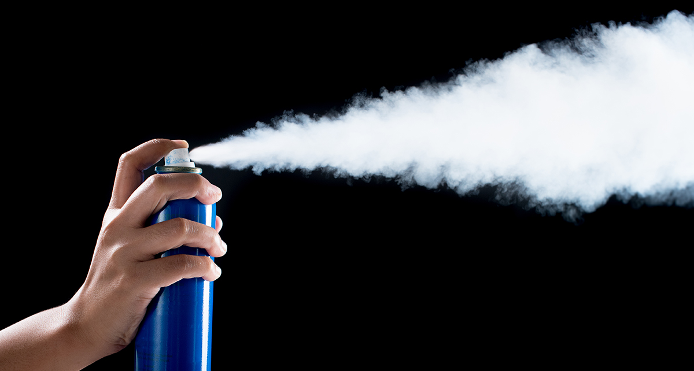
Particle size (surface area)
The total surface area of a solid or liquid reactant affects the rate of a reaction.
Use a powder instead of a big lump of material

Slide 17
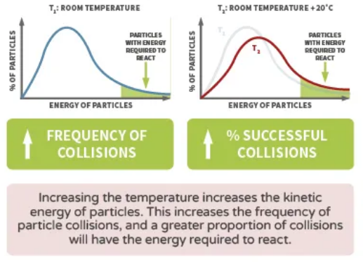
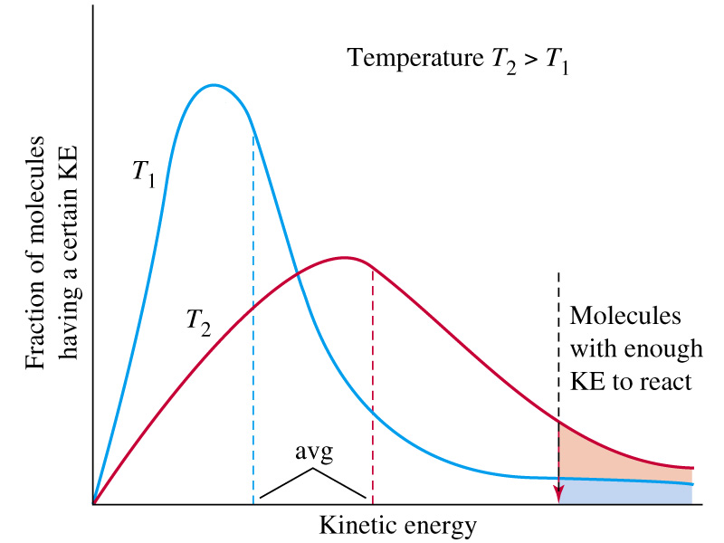
Temperature
  Increasing the temperature usually increases the reaction rate
  At higher temperatures, particles on average have a greater kinetic energy
  This means that a higher percentage of collisions have energy equal to or greater than the activations energy
  Greater percentage of collisions are successful, hence reaction rate increases

Slide 18
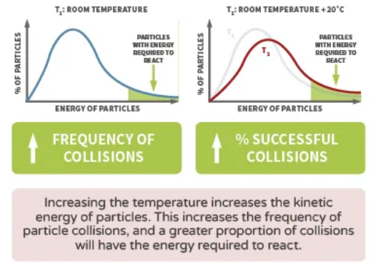
Temperature
Temperature has a two-fold effect on the rate of reaction.
  At higher temperatures, the particles move faster (the particles have a higher average speed). Higher average speed results in more frequent collisions which increases the rate of the reaction.
  At higher temperatures, the system has a higher average kinetic energy. This results is a higher probability that a particle will have sufficient kinetic energy to overcome the activation energy, so the frequency of successful collisions increases.

Slide 19
On going
Pearson chapter 18 – do section review and chapter review

